Slide 1
Chapter 5 Requirements Specification & Documentation
Source of PP slides :
- Sommerville, I. 2011. Software Engineering. 9th edn. Addison-Wesley.
- Lamsweerde, A. V. 2011. Requirements Engineering: From System goals to UML Models to Software Specification. 2nd ed.Wiley.
- Weigers, K. And Beatty, J. 2013. Software Requirements. 3rd edn. Microsoft Press.
- Bennett, McRobb and Farmer: Object Oriented Systems Analysis and Design Using UML, (4th Edition), Chapter 8, McGraw Hill, 2010.

Slide 2
Lesson Objectives
To understand different techniques can be used in requirements specification process
To evaluate alternative techniques on requirements specification

Slide 3
Chap.1: RE products and processes
alternative options
Chap. 2 & 3:
Chap. 4:
Elicitation &
Analysis
techniques
Evaluation
techniques
consolidated
start
agreed
requirements
requirements
Chap. 5:
Specification &
documentation
techniques
documented requirements

Slide 4

as introduced in Chapter 1 ...
Precise definition of all features of the agreed system
Objectives, concepts, relevant domain properties, system/software requirements, assumptions, responsibilities
Rationale for options taken
Organization of these in a coherent structure
Documentation in a form understandable by all parties
Resulting product: Requirements Document (RD)

Slide 5
Requirements specification & documentation: outline
Types of Specification
Notation for Requirements Specification
Free documentation in unrestricted natural language
Disciplined documentation in structured natural language
Local rules on writing statements
Global rules on organizing the Requirements Document
Use of diagrammatic notations
Formal Specification
Algebraic approach
Model-based approach
Beyond Functional Requirements
Specifying quality requirements
Quality attributes trade-off
Guidelines for Writing Excellent Requirements

Slide 6
Type of Requirements Specification
Requirements for a software system set out what the system should do and define constraints on it operation and implementation.
Two main different types of requirements specification :
User Requirements Document
System Requirements Document

Slide 7
User requirements
User requirements specification (sometimes known as /System Definition Document) are high-level abstract requirements. They are intended for use by people involved in using and procuring the system.
User requirements specification usually written in natural language, with easy-to-understand diagrams and tables, of what services the system is expected to provide and the constraints under which it must operate.

Slide 8

System requirements
System requirements specification (for systems with substantial software components, it was used interchangeably as Software Requirements Specification) are more precise and detail descriptions of the system’s functions, services and operational constraints →i.e. it is an extended version of user requirements
They may be written in structured form of natural language supported by system models and tables that developed during analysis.
System requirements are also used by software designers as the starting point for the system design, so they are sometimes called “functional specifications”.
They may be the basis of a contract between the system developer and customer. Therefore should be complete and consistent specification of the whole system.

Slide 9
Readers of different types of specifications
User Requirements
System Requirements
Client managers
System end-user
Client engineers
Contractor managers
System architects
System end-user
Client engineers
System architects
Software developers

Slide 10
Requirements specification & documentation: outline
Types of Specification
Notation for Requirements Specification
Free documentation in unrestricted natural language
Disciplined documentation in structured natural language
Local rules on writing statements
Global rules on organizing the Requirements Document
Use of diagrammatic notations
Formal Specification
Algebraic approach
Model-based approach
Beyond Functional Requirements
Specifying quality requirements
Quality attributes trade-off
Guidelines for Writing Excellent Requirements

Slide 11
Free documentation in unrestricted natural language
@
Unconstrained prose writing in natural language (NL) ...
J Unlimited expressiveness
J communicability
J no training needed
How about other advantages? Let’s discuss…

Slide 12
Free documentation in unrestricted natural language
@
However,
L Prone to many of the spec errors & flaws
In particular, ambiguities are inherent to NL; can be harmful
“Full braking shall be activated by any train that receives an outdated acceleration command or that enters a station block at speed higher than X m.p.h. and for which the preceding train is closer than Y yards.”
Frequent confusions among logical connectives in NL
e.g. case analysis:
If Case1 then <Statement1>
or if Case2 then <Statement2> (amounts to true!)
vs. If Case1 then <Statement1>
and if Case2 then <Statement2>
How about other problems???
i) Requirements amalgamation : several requirements expressed as a single requirement
ii) …… (Let’s discuss)

Slide 13
Disciplined documentation in structured NL: local rules on writing statements
?
Use stylistic rules for good NL spec, e.g.
Identify who will read this; write accordingly
Say what you are going to do before doing it
Make sure every concept is defined before use
Keep asking yourself: “Is this comprehensible? Is this enough? Is this relevant?”
Never more than one req, assumption, or domain properties in a single sentence. Keep sentences short.
Use “shall” for mandatory, “should” for desirable prescriptions
Avoid unnecessary jargon & acronyms
Use suggestive examples to clarify abstract statements
Supply diagrams for complex relationships among items
(More in the text book & online research…)

Slide 14
Disciplined documentation in structured NL: local rules on writing statements (2)
?
Use decision tables for complex combinations of conditions
input if-conditions
binary filling with truth values
output then-conditions
one case = AND-combination
Systematic, simple, additional benefits ...
Completeness check: 2^{N} columns required for full table
Table reduction: drop impossible cases in view of domain properties; merge 2 columns differing only by single “T”, “F” => “-”
Test cases for free (cause-effect coverage)

Slide 15

Disciplined documentation in structured NL: local rules on writing statements (3)
?
Use standardized statement templates
Identifier --suggestive; hierarchical if compound statement
Category --functional or quality req, assumption, domain property, definition, scenario example, ...
Specification --statement formulation according to stylistic rules
Fit criterion --for measurability (see next slide)
Source --for traceability to elicitation sources
Rationale --for better understanding & traceability
Interaction --contribution to, conflict with other statements
Priority level --for comparison & prioritization
Stability, Commonality levels --for change management

Slide 16
Fit criteria make statements measurable
?
Complement statements by quantifying the extent to which they must be satisfied [Robertson, 1999]
Especially important for measurability of NFRs
Spec: The scheduled meeting dates shall be convenient to participants
Fit criterion: Scheduled dates should fit the diary constraints of at least 90% of invited participants in at least 80% of cases
Spec: Info displays inside trains shall be informative & understandable
Fit criterion: A survey after 3 months of use should reveal that at least 75% of travelers found in-train info displays helpful for finding their connection

Slide 17

Disciplined documentation in structured NL: global rules on organizing the RD
Grouping rules: Put in same section all items related to common factor ...
system objective
system component
task
conceptual object
software feature
...
Global templates for standardizing the RD structure
domain-specific, organization-specific, company-specific

Slide 18


IEEE Std-830 template for organizing the RD
1. Introduction
1.1 RD purpose
1.2 Product scope
1.3 Definitions, acronyms, abbreviations
1.4 References
1.5 Overview
2. General Description
2.1 Product perspective
2.2 Product functions
2.3 User characteristics
2.4 General constraints
2.5 Assumptions & Dependencies 2.6 Apportioning of requirements
3. Specific Requirements (cont’ next slide …)
domain, scope, purpose
of system-to-be
glossary of terms
elicitation sources
sw-environment boundary:
interfaces with users,
devices, other sw
functionalities of software-to-be
assumptions about users
development constraints
(hw limitations, implem platform, ...)
environment assumptions
(subject to change)
optional, deferable reqs

Slide 19
IEEE Std-830 template for organizing the RD (2)
alternative templates for specific types of system
3. Specific Requirements
3.1 Functional requirements
3.2 External interface reqs
3.3 Performance reqs
3.4 Design constraints
3.5 Software quality attributes
3.6 Other requirements
Appendices
Index
NFRs: interoperability
NFRs: time/space performance
NFRs: development reqs
NFRs: quality reqs
NFRs: security, reliability,
maintainability
Variant: VOLERE template [Robertson, 1999]
explicit sections for domain properties, costs, risks, development workplan, ...

Slide 20
Requirements specification & documentation: outline
Types of Specification
Notation for Requirements Specification
Free documentation in unrestricted natural language
Disciplined documentation in structured natural language
Local rules on writing statements
Global rules on organizing the Requirements Document
Use of Diagrammatic Notations
Formal Specification
Algebraic approach
Model-based approach
Beyond functional Requirements
Specifying quality requirements
Quality attributes trade-off
Guidelines for writing excellent requirements

Slide 21
Use of diagrammatic notations
Some commonly used of Diagrammatic Notations:
System scope: Context diagram
Conceptual structures: Entity-Relationship diagram (ERD)
Information flows: Data Flow diagrams (DFD)
System operations: Use Case diagrams
Interaction scenarios: Sequence diagrams
System behaviors: State machine diagrams
Stimuli and responses: R-net diagrams
{Note : Some of the above diagrams already covered in Chapter 3, SAD course & Database course. We will discuss Sequence Diagram and R-net Diagram in this chapter.}

Slide 22
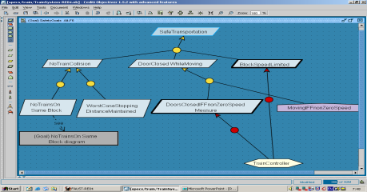
Use of diagrammatic notations
Diagrammatic notations:
To complement or replace NL prose
Dedicated to specific aspects of the system (as-is or to-be)
Graphical representation:
to ease communication
provide overview
Semi-formal ...
Declaration of items and their inter-relationship in formal language (syntax, semantics)
=> surface checks on RD items, machine-processable
Informal spec of item properties in NL
This chapter: sample of frequently used diagrams

Slide 23
System scope: context diagrams
Declare system components & their interfaces [DeMarco ’78]
-> Refer to Chapter 3 and SAD course
=> - system structure
- what is in system, what is not
- environment of each component: neighbours, interfaces

Slide 24
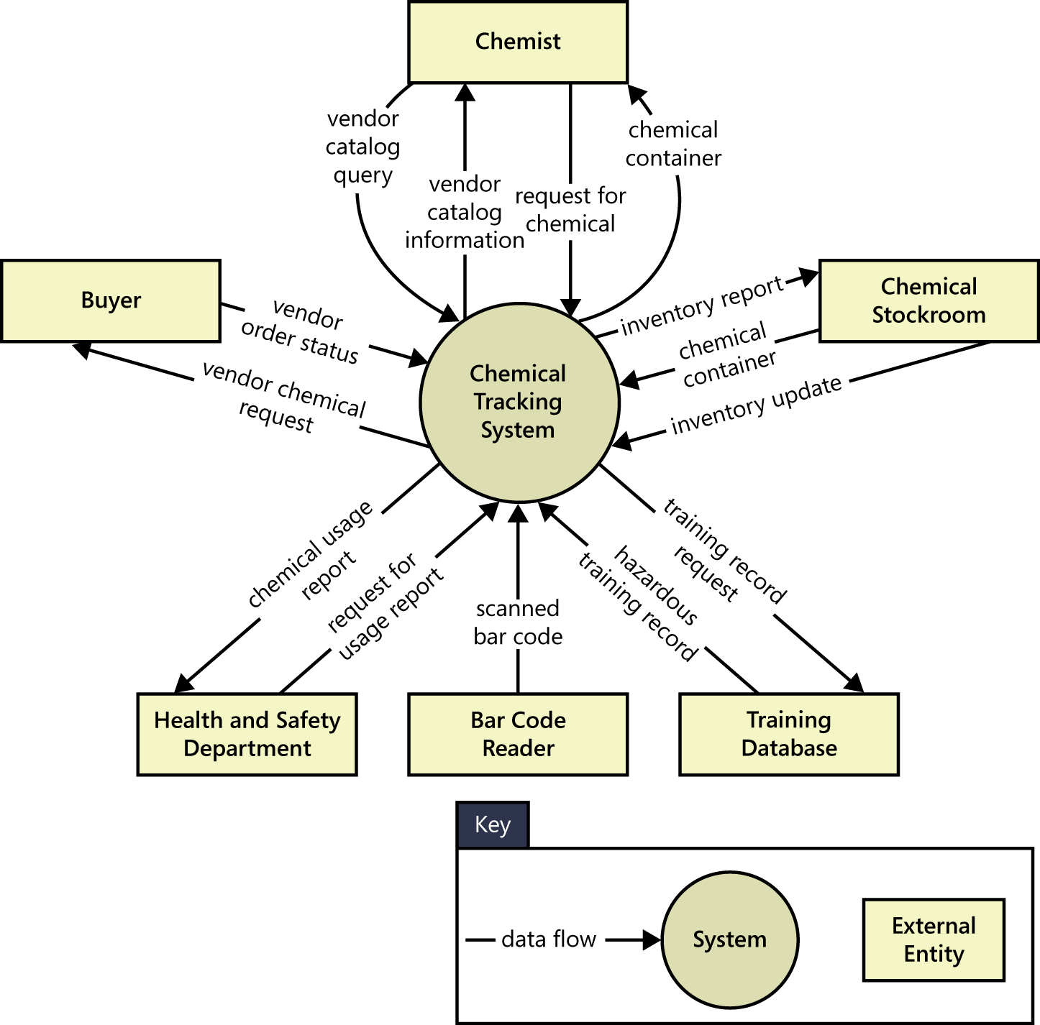
context diagram : Example

Slide 25
Conceptual structures: entity-relationship diagrams (1)
Declare conceptual items, structure them → Refer to Chapter 3 and DB course
Entity: class of concept instances ...
having distinct identities
sharing common features (attributes, relationships)
e.g. Meeting, Participant
N-ary relationship: feature conceptually linking N entities, each playing a distinctive role (N ≥ 2)
Multiplicity, one one side: min & max number of entity instances, on this side, linkable at same time to single tuple of entity instances on the other sides
e.g. Invitation linking Participant and Meeting
Attribute: feature intrinsic to an entity or a relationship
has range of values
e.g. Date of Meeting

Slide 26
Entity-relationship diagrams (2)
Entity specialization: subclass of concept instances, further characterized by specific features (attributes, relationships)
by default, inherits attributes & relationships from superclass
rich structuring mechanism for factoring out structural commonalities in superclasses
e.g. ImportantParticipant, with specific attribute Preferences
Inherits relationships Invitation, Constraints, attribute Address
(Email of ImportantParticipant inhibits default inheritance)
Diagram annotations: to define elements precisely
essential for avoiding spec errors & flaws
e.g. annotation for Participant:
“Person expected to attend the meeting, at least partially, under some specific role. Appears in the system when the meeting is initiated and disappears when the meeting is no longer relevant to the system”

Slide 27
Entity-relationship diagram: Example
role
binary relationship
entity
specialization
attribute
attributes of
relationship
A meeting invites at least 1 up to
an arbitrary number of participants
Multiplicities may capture requirements or domain properties
L No distinction between prescriptive & descriptive

Slide 28
Information flows: data flow diagrams (DFD)
- Capture system operations linked by data dependencies
→ Refer to Chapter 3 and SAD course.
Operation/ Process = data transformation activity
Input, output links = data flows
operation needs data flowing in to produce data flowing out
(≠ control flow !)
Data transformation rule to be specified ...
in annotation (structured NL)
or in another DFD (operation refinement, cf. SADT)
System components, data repositories = origins, ends of flow
Consistency/completeness rules checkable by tools, cf. SADT

Slide 29
Data flow diagram: example
input data
flow
output data
flow
copyOf
Initiator
constraints
Request
Participant
meeting
invalid
Request
Request
Ask
operation
meeting
Check
validRequest
Constraints
Notification
Request
meeting
constraintRequest
Collect
Merge
Constraints
Determine
Constraints
Constraints
Schedule
Participant
individual
Constraints
participantConstraints
data repository
system component

Slide 30
System operations: use case diagrams
- Capture operations to be performed by a system component
& interactions with other components → Refer to Chapter 3
yet simpler, outline view ... but vague
to be made precise by annotations, interaction scenarios, ...
introduced in UML to replace DFDs
Structuring mechanisms ...
<<include>>: to specify “suboperation”
<<extend>> + precondition: to specify “variant” operation
in exception case

Slide 31
Use case diagram: example
environment
component
operation
interaction
Check Request
Ask
Constraints
Initiator
<<extend>>
Unauthorized
Collect
Participant
variant
operation
Deny Request
Constraints
Determine
Merge
Schedule
Constraints
software
component
<<include>>
Resolve
Conflict
Participant
Conflicts
Resolver
suboperation
Scheduler
operation performer

Slide 32
Interaction scenarios: Sequence diagrams
- Capture positive scenarios by sequences of interactions
among instances of system components
Sequence Diagrams (UML) {cover in this chapter}
Parallel composition of timelines
one per component instance
Pairwise directed interactions down timelines
information transmission through event attributes
Interaction event synchronously controlled by source instance & monitored by target instance
total order on events along timeline (event precedence)
partial order on all diagram events

Slide 33
Interaction scenarios: Sequence diagrams
Shows an interaction between lifelines (e.g. objects) arranged in a time sequence.
Can be drawn at different levels of detail and to meet different purposes at several stages in the development life cycle.
Typically used to represent the detailed object interaction that occurs for one use case or for one operation.

Slide 34
Interaction scenarios: Sequence diagrams
Vertical dimension shows time.
Objects (or subsystems or other connectable objects) involved in interaction appear horizontally across the page and are represented by lifelines.
Messages are shown by a solid horizontal arrow.
The execution or activation of an operation is shown by a rectangle on the relevant lifeline.

Slide 35
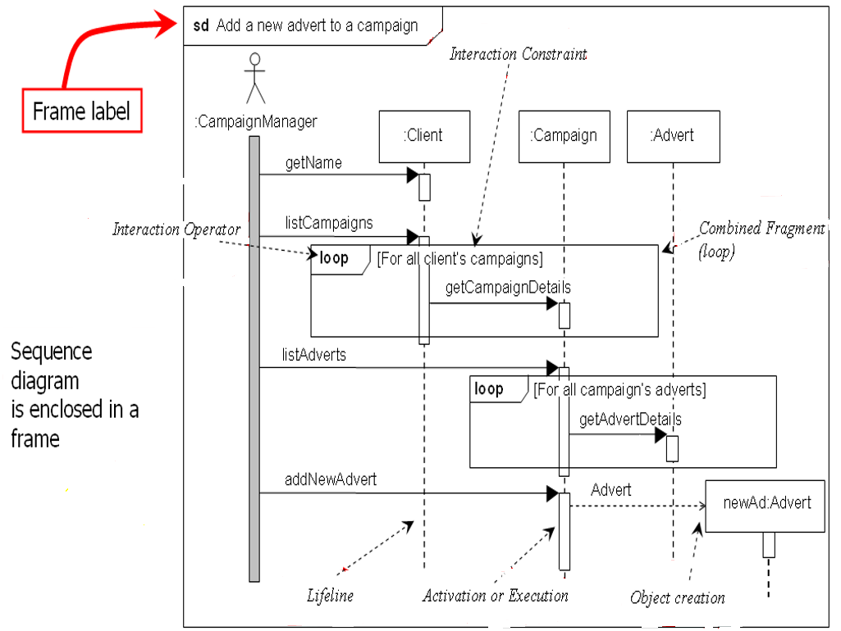
Sequence Diagram

Slide 36
Interaction scenarios: Sequence diagrams
Iteration is represented by combined fragment rectangle with the interaction operator ‘loop’.
The loop combined fragment only executes if the guard condition in the interaction constraint evaluates as true.
Object creation is shown with the construction arrow (dashed) going to the object symbol for the Advert lifeline.
A synchronous message or procedural call is shown with a full arrowhead, causes the invoking operation to suspend execution until the focus of control has been returned to it.

Slide 37
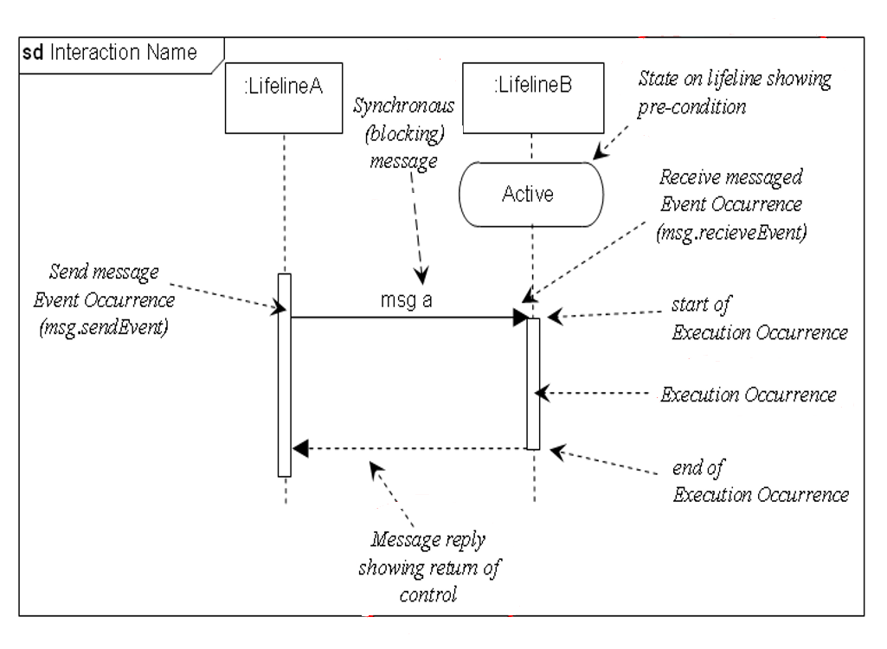
Sequence Diagram

Slide 38
Interaction scenarios: Sequence diagrams
Most use cases imply at least one boundary object that manages the dialogue between the actor and the system – in the next sequence diagram it is represented by the lifeline :AddAdvertUI
The control object is represented by the lifeline :AddAdvert and this manages the overall object communication.
(Problem Domain) Entity Classes represent the layer that will map to data access layer(classes)

Slide 39
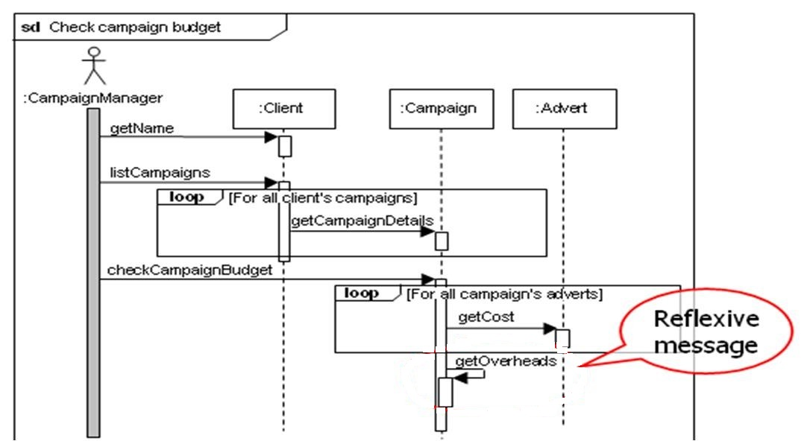
Sequence Diagram

Slide 40
Sequence Diagram – Focus of Control
Indicates times during an activation when processing is taking place within that object.
Parts of an activation that are not within the focus of control represent periods when, for example, an operation is waiting for a return from another object.
May be shown by shading those parts of the activation rectangle that correspond to active processing by an operation.

Slide 41
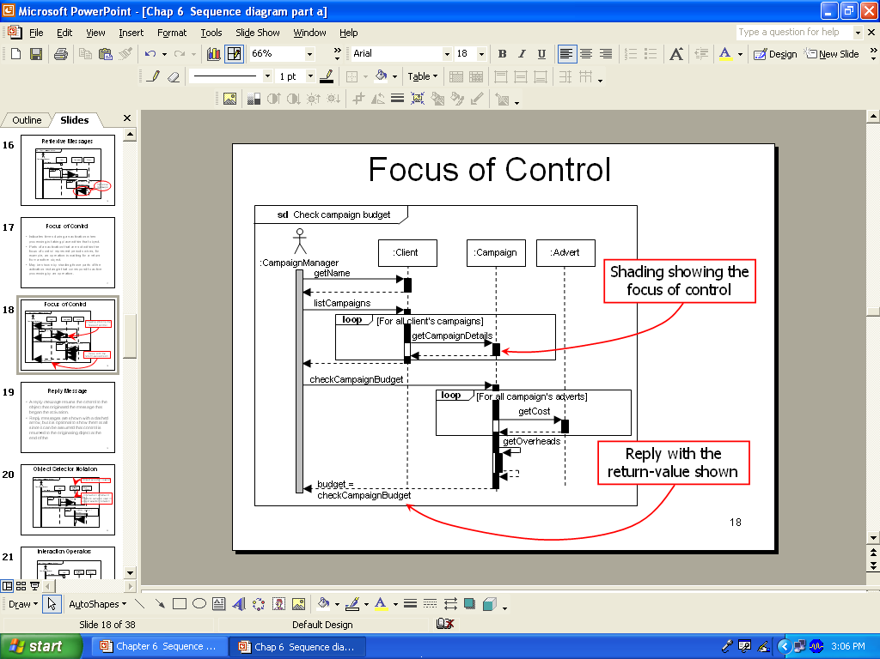
Sequence Diagram – Focus of Control

Slide 42
Sequence Diagram – Reply Message
A reply message returns the control to the object that originated the message that began the activation.
Reply messages are shown with a dashed arrow, but it is optional to show them at all since it can be assumed that control is returned to the originating object at the end of the activation.

Slide 43
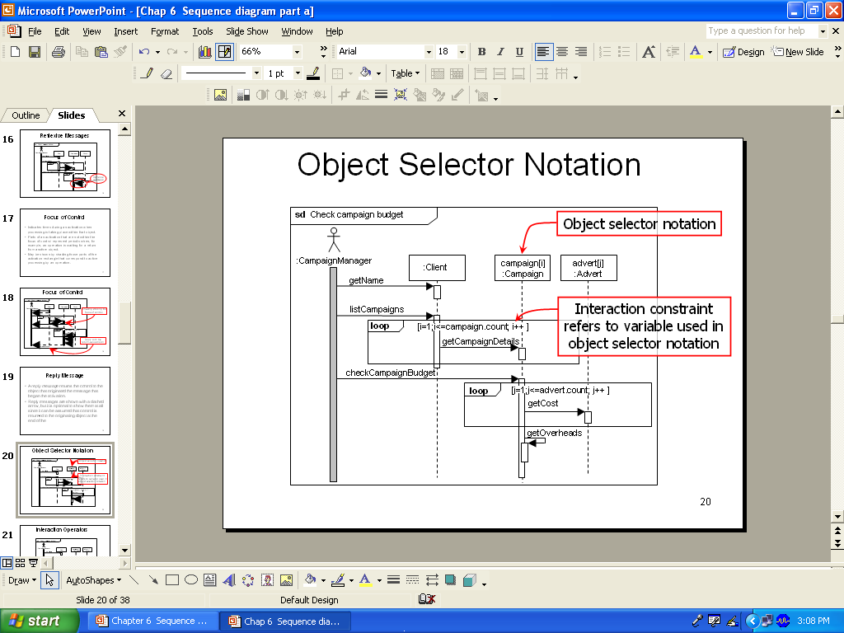
Sequence Diagram – Object Selector Notation

Slide 44
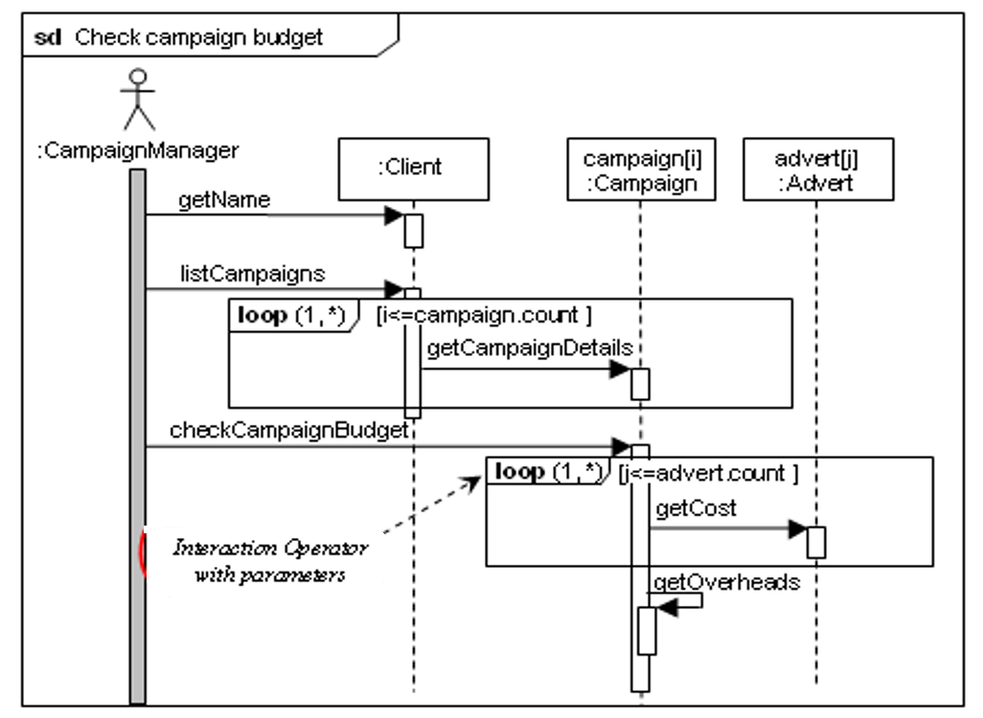
Sequence Diagram – Interaction Operators

Slide 45
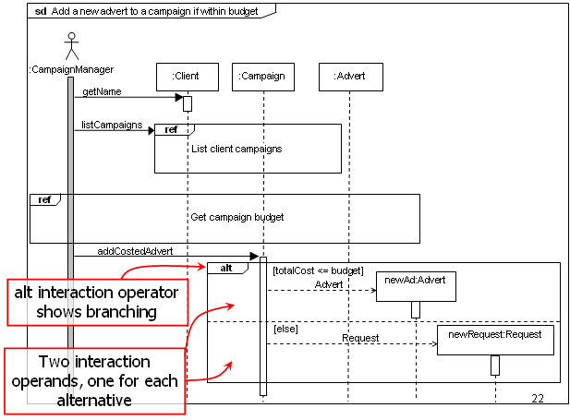

Slide 46
Sequence Diagram – Interaction Operators
Interaction Operator | Explanation and Use
alt | Alternatives represents alternative behaviours, each choice of behaviour being shown in a separate operand. The operand whose interaction constraint is evaluted as true executes.
opt | Option describes a single choice of operand that will only execute if its interaction contraint evaluates as true.
break | Break indicates that the combined fragment is performed instead of the remainder of the enclosing interaction fragment.
loop | Loop is used to indicate an operand that is repeated a number times until the interaction constraint for the loop is no longer true.

Slide 47
Sequence Diagram – Interaction Operators
Interaction Operator | Explanation and Use
par | Parallel indicates that the execution operands in the combined fragment may be merged in any sequence once the event sequence in each operand is preserved.
seq | Weak Sequencing results in the ordering of each operand being maintained but event occurrence from different operands on different lifelines may occur in any order. The order of event occurrences on common operands is the same as the order of the operands.
neg | Negative describes an operand that is invalid.
critical | Critical Region imposes a constraint on the operand that none of its event occurrences on the lifelines in the region can be interleaved.

Slide 48
Sequence Diagram – Interaction Operators
Interaction Operator | Explanation and Use
ignore | Ignore indicates the message types, specified as parameters, that should be ignored in the interaction.
consider | Consider states which messages should be consider in the interaction. This is equivalent to stating that all others should be ignored.
assert | Assertion states that the sequence of messaging in the operand is the only valid continuation.
strict | Strict Sequencing imposes a strict sequence on execution of the operands but does not apply to nested fragments.

Slide 49
Sequence Diagram – Handling Complexity
Complex interactions can be modelled using various different techniques
1. Interaction fragments
2. Lifelines for subsystems or groups of objects
3. Continuations
4. Interaction Overview Diagrams {self research & reading}

Slide 50
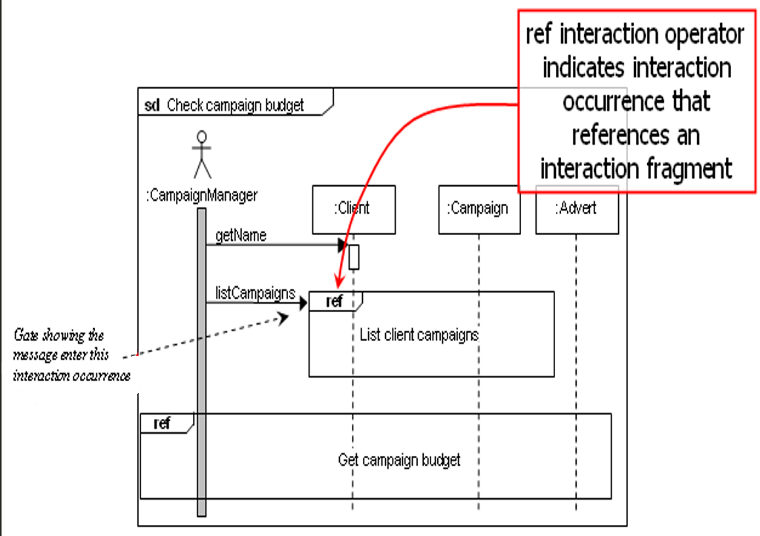
Sequence Diagram – Handling Complexity
1. Interaction fragments

Slide 51
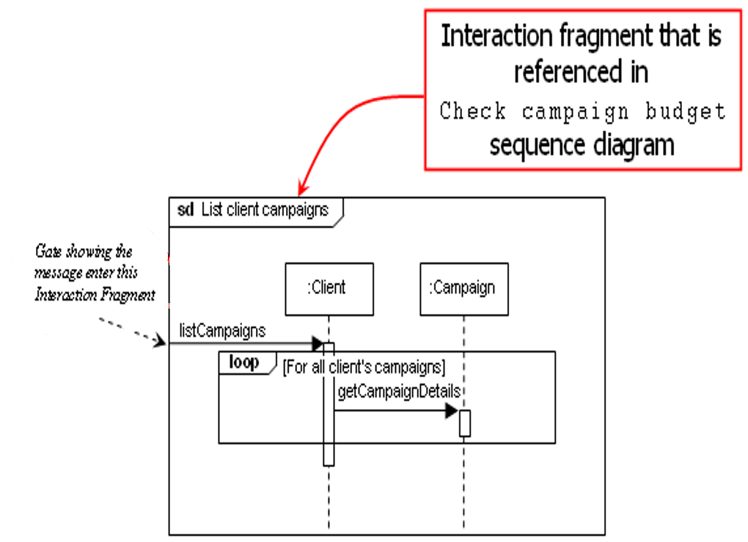
Sequence Diagram – Handling Complexity
1. Interaction fragments

Slide 52
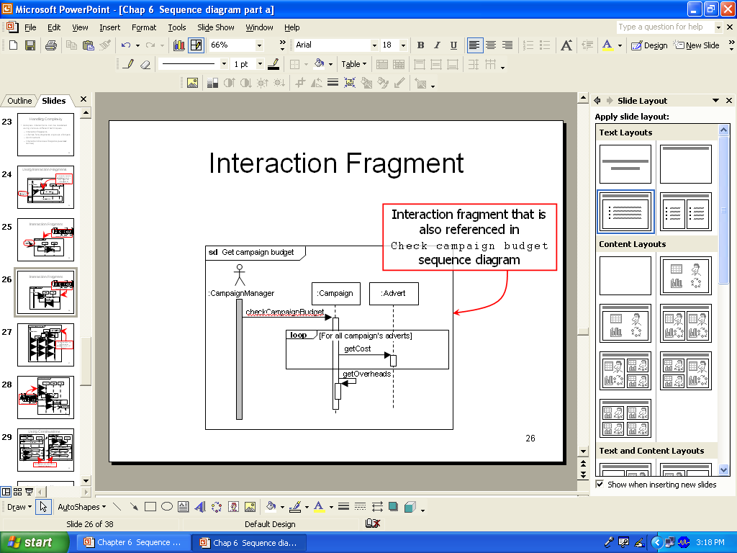
Sequence Diagram – Handling Complexity
1. Interaction fragments

Slide 53
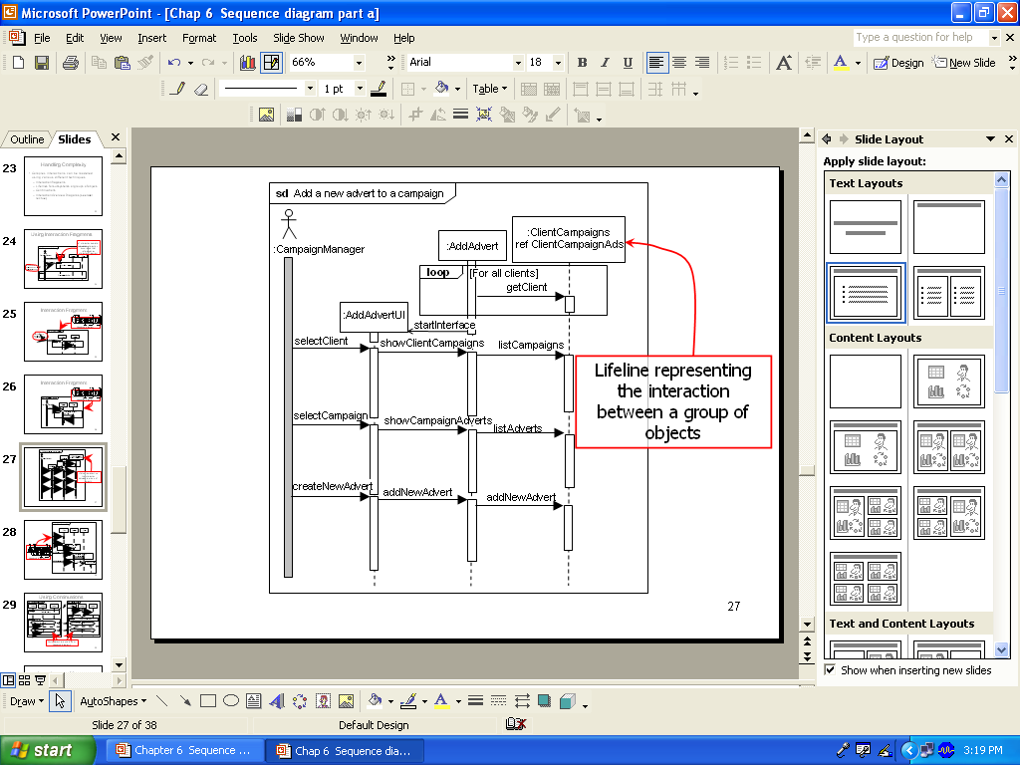
Sequence Diagram – Handling Complexity
2. Lifelines for subsystems or groups of objects

Slide 54
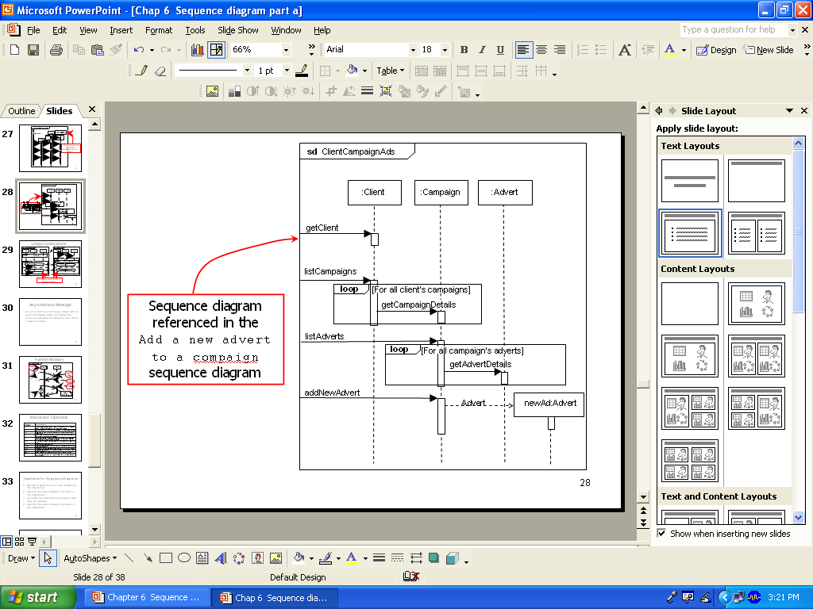
Sequence Diagram – Handling Complexity
2. Lifelines for subsystems or groups of objects

Slide 55
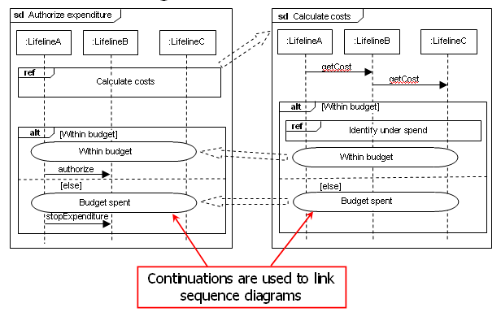
Sequence Diagram – Handling Complexity
3. Continuation

Slide 56
Sequence Diagram – Asynchronous Message
An asynchronous message, drawn with an open arrowhead, does not cause the invoking operation to halt execution while it awaits a return.

Slide 57
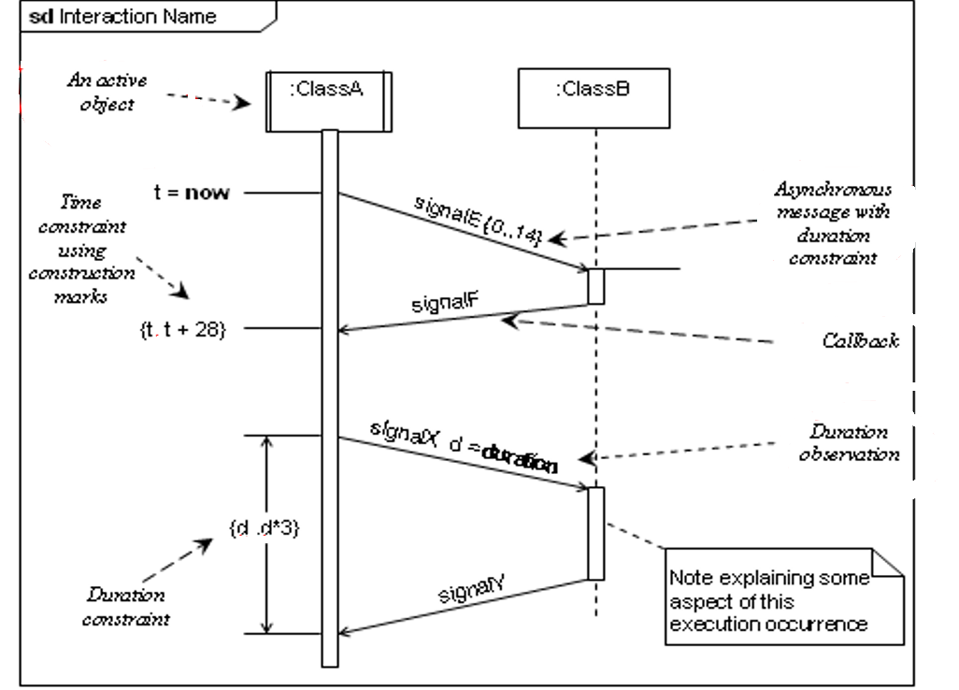
Sequence Diagram – Asynchronous Message

Slide 58
Sequence Diagram - Guidelines
Decide at what level you are modelling the interaction.
Identify the main elements involved in the interaction.
Consider the alternative scenarios needed.
Identify the main elements involved in the interaction.
Draw the outline structure of the diagram.
Add the detailed interaction.
Check for consistency with linked sequence diagrams and modify as necessary.
Check for consistency with other UML diagrams (class diagram) or models.

Slide 59
System behaviors: state diagrams
- Capture the admissible behaviors of system components
-> Refer to Chapter 3
Behavior of component instance =
sequence of state transitions for the items it controls
State = set of situations where a variable characterizing
a controlled item has always the same value
Initial or final states = states where item appears, disappears
States may have some duration
State/Object transition: caused by associated event
if item in source state and event ev occurs
then it gets to target state
Events are instantaneous phenomena

Slide 60
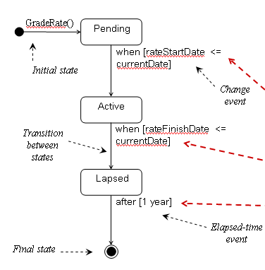
Example : State Diagram – GradeRate Class
Movement from one state to another is dependent upon events that occur with the passage of time.

Slide 61
Stimuli and responses: R-net diagrams
- Capture all required responses to single stimulus
{Cover in this chapter}
chain of response operations to be performed by a system component
operation may generate stimuli for other R-nets
Decision points, operation application under conditions
Good for visualizing ...
answers to WHAT IF ? questions
required software reactions to environment events

Slide 62
R-net diagram: example
input stimulus
precedence
response operation
decision point

Slide 63
Integrating multiple system views
Diagrams of different types cover different, complementary views of the system (as-is or to-be)
components & interfaces, conceptual structures, operations, flows, interaction scenarios, behaviors, ....
Overlapping aspects => integration mechanism needed for ensuring compatibility & complementarity among diagrams
Standard mechanism: inter-view consistency rules the specifier should meet
cf. static semantics rules enforced by compilers
“every used variable must be declared”
“every declared variable must be used”, ...
can be used for inspection checklists
enforceable by tools
constrain diagram evolution

Slide 64
Inter-view consistency rules: examples
Every component & interconnection in a problem diagram must be further specified in an ET diagram
Every shared phenomenon in a problem diagram must appear as event in an ET diagram or as entity, attribute, or relationship in an ER diagram
Every data in a flow or repository of a DFD diagram must be declared as entity, attribute, or relationship in an ER diagram
Every state in a SM diagram must correspond to some value for some attribute or relationship in an ER diagram
Every interaction event in an ET scenario must appear in a corresponding SM diagram

Slide 65
Diagrammatic notations: pros & cons
Formal declaration of different system facets
+ informal annotations of properties for higher precision
Graphical declaration =>
J overview & structuring of important aspects
J easy to understand, communicate
J surface-level analysis, supported by tools (e.g. query engines)
Semi-formal specification =>
L language semantics may be vague (different interpretations)
L only surface-level aspects formalized, not item properties
L limited forms of analysis
L functional and structural aspects only
=> formal specification needed for mission-critical aspects

Slide 66
Requirements specification & documentation: outline
Types of Specification
Notation for Requirements Specification
Free documentation in unrestricted natural language
Disciplined documentation in structured natural language
Local rules on writing statements
Global rules on organizing the Requirements Document
Use of diagrammatic notations
Formal Specification
Algebraic approach
Model-based approach
Beyond Functional Requirements
Specifying quality requirements
Quality attributes trade-off
Guidelines for Writing Excellent Requirements

Slide 67
Formal specification – Introduction (1)
- In the 1980s, many SE researchers proposed that the use of formal development method was the best way to improve software quality
- However, it has NOT become the mainstream software development techniques as was once predicted:
Other software engineering techniques (eg SQM, S/W testing, SRE etc) have been successful at increasing system quality.
Market changes have made time-to-market rather than software with a low error count the key factor.
The scope of formal methods is limited. They are not well-suited to handle user interfaces and user interaction.
Formal methods are hard to scale up to large systems.
L
disadv

Slide 68
Formal specification – Introduction (2)
- The main area of applicability is in critical systems.
The principal benefits of formal methods are in reducing the number of faults in systems.
- Formal methods are most likely to be cost-effective where high system failure costs must be avoided.
- Formal specifications are expressed in a mathematical notation with precisely defined vocabulary, syntax and semantics.
→ Prepared in a detailed way to prove
that it works !
J
Advantages

Slide 69
Development costs with formal specification
With Formal Spec.

Slide 70

Approaches to Formal specification
2 fundamental approaches to formal specification:
i) Algebraic approach – system is described in terms of operations and their relationship
ii) Model-based approach – system is specified in terms of a state model that is constructed using mathematical constructs such as sets and sequences. Operations are defined by modifications to the system’s state.

Slide 71
Formal specification languages

Slide 72

Algebraic Specification of sub-system interfaces
Large systems are normally comprised of sub-systems with well-defined interfaces.
Specification of these interfaces allows for their independent development.
Interfaces are often defined as abstract data types (“sorts”) or objects.
The algebraic approach is particularly well-suited
to the specification of such interfaces.

Slide 73
Sub-system interfaces

Slide 74
The structure of an algebraic specification
< SPECIFICA
TION NAME >
sort
< name >
imports
< LIST
OF SPECIFICA
TION NAMES >
Inf
or
mal descr
iption of the sor
t and its oper
ations
Oper
ation signatures setting out the names and the types of
the parameters to the operations defined over the sort
Axioms defining the oper
ations o
v
er the sor
t

Slide 75
Algebraic specification components
Introduction – defines the sort/ object/ abstract data type (type name) and declares other specifications that are used
Description – informally describes the operations on the type
Signature – defines the syntax of the operations in the interface and their parameters
Axioms – defines the operation semantics by defining axioms which characterize behavior

Slide 76
Types of operations
Constructor operations: operations which create / modify entities of the type
Inspection operations: operations which evaluate entities of the type being specified
Rule of thumb for defining axioms: define an axiom which sets out what is always true for each inspection operation over each (primitive) constructor operation.

Slide 77

Example : a simple List specification
LIST
( Elem )
Introduction
sort
List
A FIFO linear list
imports
INTEGER
Defines a list where elements are added at the end and removed from the front. The operations are Create, which brings an empty list into existence; Cons, which creates a new list with an added member; Length, which evaluates the list size; Head, which evaluates the front element of the list; and Tail, which creates a list by removing the head from its input list. Undefined represents an undefined value of type Elem.
Informal
Description
Create → List
Operator names + type info for argument(s) & result
Signature
Cons (List, Elem) → List
Head (List)
→
Elem
Length (List)
→
Integer
T
ail (List)
→
List
1
2
3
4
5
6
Head (Create) = Undefined
exception
(empty list)
Axioms
Head (Cons (L, v)) =
if
L
=Create
then
v
else
Head (L)
Length (Create) = 0
Defines Tail in terms of Create and Cons
Length (Cons (L, v)) = Length (L) + 1
T
ail (Create ) = Create
T
ail (Cons (L, v)) =
if
L
=Create
then
Create
else
Cons (T
ail (L), v)

Slide 78

Operations on a “List” abstract data type
Constructor operations which create or modify sort List: Create, Cons and Tail
Inspection operations which discover attributes of sort List: Head and Length
Tail is not a primitive operation since it can be defined using Create and Cons. (Thus, axioms are not required for Head and Length over Tail.)

Slide 79
Model-based specification
Z is a mature notation for model-based specification. It combines formal and informal descriptions and incorporates graphical highlighting.
The basic building blocks of Z-based specifications are schemas.
Schemas identify state variables and define constraints and operations in terms of those variables.

Slide 80
The structure of a Z schema
Natural numbers (0, 1, 2, …)
NAME
Container
contents: N
capacity: N
SIGNATURE
(defines scheme state)
PREDICATE
contents ≤ capacity
(invariants, pre- & post-conditions)

Slide 81
Example : An insulin pump
insulin
delivery
glucose level
text messages
dose delivered

Slide 82
Example: Modelling the insulin pump
The schema models the insulin pump as a number of state variables
reading? from glucose level sensor
dose, cumulative_dose
r0, r1, r2 last 3 glucose level readings
capacity insulin pump reservoir level
alarm! signals exceptional conditions
pump! output for insulin pump device
display1!, display2! text messages & dose
Names followed by a ? are inputs, names followed by a ! are outputs.

Slide 83
Example : Insulin pump state schema signature

Slide 84
Schema predicates
Each Z schema has an predicate part which defines conditions that are always true (schema invariants)
For the insulin pump schema, for example, it is always true that:
The dose must be less than or equal to the capacity (= level) of the insulin reservoir.
No single dose may be more than 4 units of insulin and the total dose delivered in a time period must not exceed 25 units of insulin. This is a safety constraint.
display2! shows the amount of insulin to be delivered.

Slide 85
Example : Insulin pump schema predicate

Slide 86
Example : The dosage computation
The insulin pump computes the amount of insulin required by comparing the current reading with two previous readings.
If these suggest that blood glucose is rising then insulin is delivered.
Information about the total dose delivered is maintained to allow the safety check invariant to be applied.
Note that this invariant always applies - there is no need to repeat it in the dosage computation.

Slide 87
Example : RUN schema
operations change state
imports state & predicates
x′ - value of x after operation

Slide 88
Example : RUN schema (cont'd)

Slide 89
Requirements specification & documentation: outline
Types of Specification
Notation for Requirements Specification
Free documentation in unrestricted natural language
Disciplined documentation in structured natural language
Local rules on writing statements
Global rules on organizing the Requirements Document
Use of Diagrammatic Notations
Formal Specification
Algebraic approach
Model-based approach
Beyond Functional Requirements
Specifying quality requirements
Quality attributes trade-off
Guidelines for Writing Excellent Requirements

Slide 90
Specifying Quality requirements
Specifying quality requirements are important in a good RD
Some samples quality requirements:
Availability
AVL-1. The system shall be at least 95 percent available on weekdays between 6:00 A.M. and midnight Eastern Time, and at least 99 percent available on weekdays between 3:00 P.M. and 5:00 P.M. Eastern Time.
Integrity
INT-3. The Chemical Tracking System shall confirm that an encoded chemical structure imported from third-party structure-drawing tools represents a valid chemical structure.
Interoperability
IOP-1. The Chemical Tracking System shall be able to import any valid chemical structure from the ChemDraw (version 13.0 or earlier) and MarvinSketch (version 5.0 or earlier) tools.

Slide 91
Specifying Quality requirements
Some samples quality requirements:
Performance
PER-1. Authorization of an ATM withdrawal request shall take no more than 2.0 seconds.
Security
SEC-1. The system shall lock a user’s account after four consecutive unsuccessful logon attempts within a period of five minutes.
Reliability
REL-1. No more than 5 experimental runs out of 1,000 can be lost because of software failures.
Safety
SAF-4. The system shall terminate any operation within 1 second if the measured tank pressure exceeds 90 percent of the specified maximum pressure.

Slide 92
Specifying Quality requirements
Some samples quality requirements:
Efficiency
EFF-1. At least 30 percent of the processor capacity and memory available to the application shall be unused at the planned peak load conditions.
Reusability
REU-2. At least 30 percent of the application architecture shall be reused from the approved reference architectures.
(Reading : More examples of specifying quality requirements in text book - Weigers, K. And Beatty, J. 2013. Software Requirements. 3rd edn. Microsoft Press.)

Slide 93
Quality attributes trade-off
Certain attributes combinations have inescapable trade-offs
Different projects will demand different sets of quality attributes for success
Users and developers must decide which attributes are more important than others
The following figure in next slide illustrates some typical interrelationships among quality attributes
For eg: increasing security likely will hurt performance because the system must go through more layers of user authentications, encryption, and malware scanning.

Slide 94
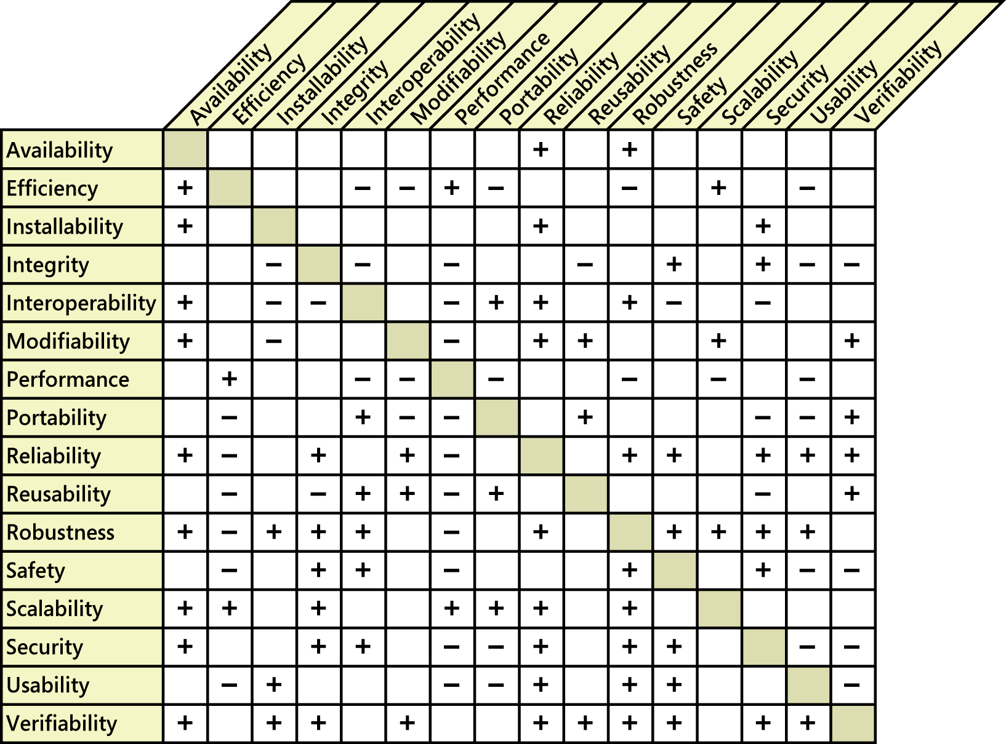
Quality attributes trade-off
FIGURE : Positive and negative relationships among selected quality attributes.

Slide 95
Requirements specification & documentation: outline
Types of Specification
Notation for Requirements Specification
Free documentation in unrestricted natural language
Disciplined documentation in structured natural language
Local rules on writing statements
Global rules on organizing the Requirements Document
Use of diagrammatic notations
Formal Specification
Algebraic approach
Model-based approach
Beyond Functional Requirements
Specifying quality requirements
Quality attributes trade-off
Guidelines for Writing Excellent Requirements

Slide 96
Guidelines for writing excellent requirements
i) System or user perspective
Write functional requirements from the perspective of either something does or something the user can do.
A generic template for a requirements written from a system’s perspective :
[optional precondition][optional trigger event] the system shall [expected system response]
Eg: If the requested chemical is found in the chemical stockroom, the system shall display a list of all containers of the chemical that are currently in the stockroom.

Slide 97
Guidelines for writing excellent requirements
i) System or user perspective(cont’)
A generic template for a requirements written from a user’s perspective :
The [user class or actor name] shall be able to [do something] [ to some objects] [qualifying conditions, response time, or quality statements]
Eg: The Chemist shall be able to reorder any chemical he has ordered in the past by retrieving and editing the order details.

Slide 98
Guidelines for writing excellent requirements
ii) Writing Style
Clarity and conciseness
The keyword “shall”
Active voice
Individual requirements
avoid using “and” & “or”; it leaves the interpretations up to the reader
avoid using “unless”, “except” & “but”; it indicates the presence of multiple requirements

Slide 99
Guidelines for writing excellent requirements
iii) Level of detail
Appropriate detail
Consistent granularity
iv) Representation techniques
Consider the most effective way to communicate each requirement to the intended audience
natural language, lists, tables, models, charts, mathematical formulas, photographs, sound clips, video clips and etc
v) Avoiding ambiguity
vi) Avoiding Incompleteness

Slide 100
ANY QUESTION…

